Slide 1
Energy Storage Participation in PJM
Adam Keech
Executive Director, Market Operations, PJM
Energy Storage Roundtable
February 22, 2017

Slide 2
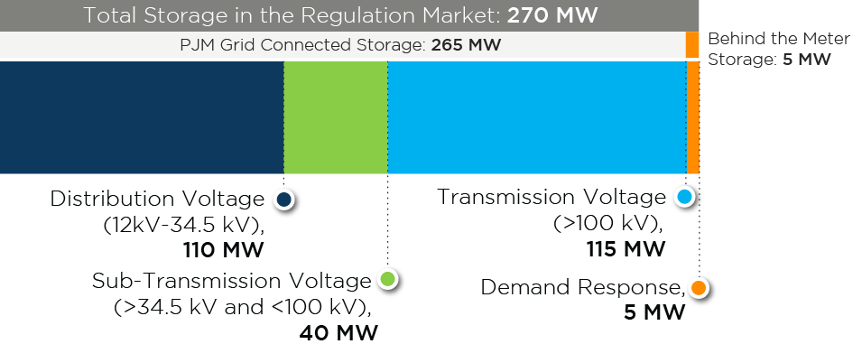
Storage at All Voltages

Slide 3
Regulation: Choosing the right tool for the job…
Notes:
Energy storage (left), Steam (right)
Need both, but each has a specific skill set. Finding optimal mix is key.

Slide 4
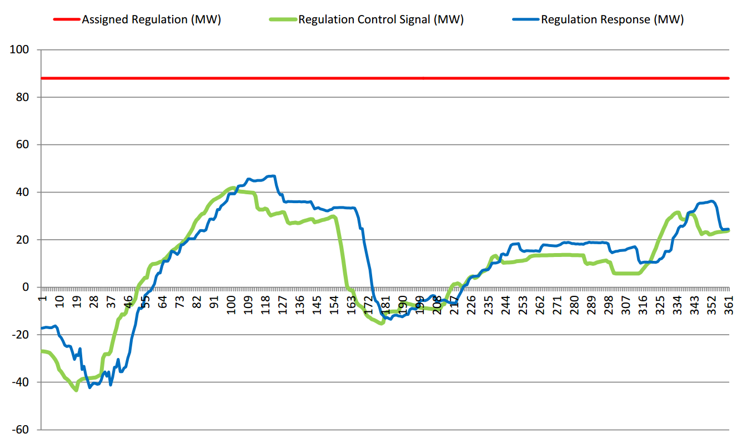
Measuring Performance
Accuracy, 95%
Precision, 74%
Delay, 66%
Score, 78%
(MW)*($/MW)*(Performance Score) = Revenue

Slide 5
Regulation Problem Statement
Reliability Issue: RegD control signal moving in the opposite direction of ACE control
Need RegD signal to provide ACE control at all times, no counter ACE control movement
Market Issue: Inconsistency in the market optimization and financial signal for the RegD market place

Slide 6
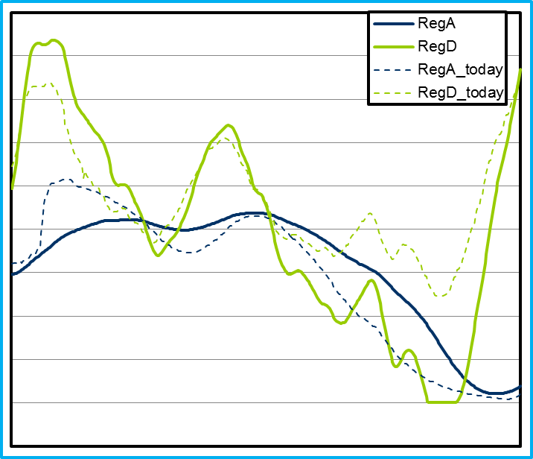
New Regulation Signals
Updated PJM regulation signals goals
ACE Control
Respect resource limitations
Reg-A: Traditional Signal
Accommodation for unit ramping
Reg-D: Dynamic Signal
30 minute conditionally neutral signal
Signal will opportunistically charge/discharge to keep signal neutral over 30 minute period (only when RegA available)

Slide 7
Storage/DER NOPR
Key Points:
Changes are underway in PJM!
Storage can already participate today. Rules may need refinement.
Clarity is needed from FERC on state/federal jurisdictional issues.
In front of the meter with occasional retail use
Behind the meter with wholesale injections
RESPECT, not MANAGE, state of charge.

Slide 8
Let’s Talk . . .

